Slide 1


Slide 2



Slide 4
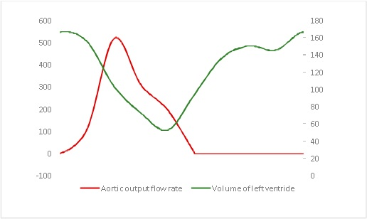
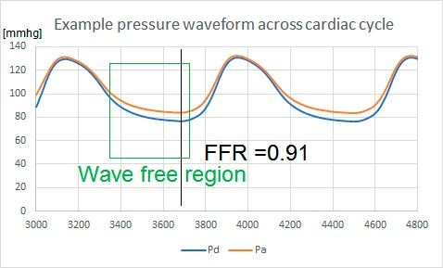
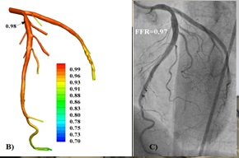
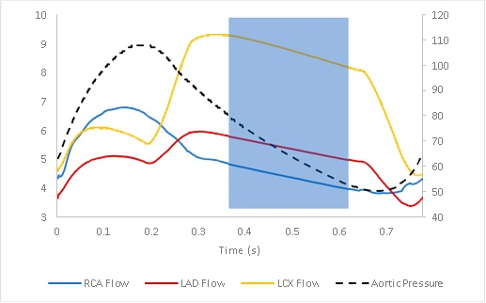

Slide 5
The impact of hyperaemic conditions on the flow reserve including iFR—an indicator based on the non-hyperaemic resting condition (baseline conditions)
The pulsatile FFR was calculated as the average of Pd/Pa throughout the cardiac cycle, whereas iFR was only in the wave-free (diastolic) region

Slide 6
The impact of hyperaemic conditions on the flow reserve including iFR—an indicator based on the non-hyperaemic condition ((baseline conditions)
The pulsatile FFR was calculated as the average of Pd/Pa throughout the cardiac cycle, whereas iFR was only in the wave-free (diastolic) region

Slide 7
The impact of hyperaemic conditions on the flow reserve including iFR—an indicator based on the non-hyperaemic condition ((baseline conditions)
The pulsatile FFR was calculated as the average of Pd/Pa throughout the cardiac cycle, whereas iFR was only in the wave-free (diastolic) region

Slide 8
The impact of hyperaemic conditions on the flow reserve including iFR—an indicator based on the non-hyperaemic condition ((baseline conditions)
The pulsatile FFR was calculated as the average of Pd/Pa throughout the cardiac cycle, whereas iFR was only in the wave-free (diastolic) region

Slide 9
The maximum difference of FFR between pulsatile and steady inflow conditions was 0.02 (2.4%), approximately at a level similar to a reported uncertainty level of clinical FFR measurement (3–4%).
The flow with steady BC appeared to represent well the diastolic phase of pulsatile flow, where FFR is measured.
Though the difference between patient-specific and population average BCs affected the flow more, the maximum discrepancy of FFR was 0.07 (8.3%), despite the patient-specific inflow of one patient being nearly twice as the population average.
Conclusions: In the patients investigated, the type of inflow boundary condition, especially flow pulsatility, does not have a significant impact on computed FFRs in narrowed coronary arteries.

